Slide 1
Taping OAI
Process Improvement…
By Zulhisham Tan – S1609
15th December 2011

Slide 2

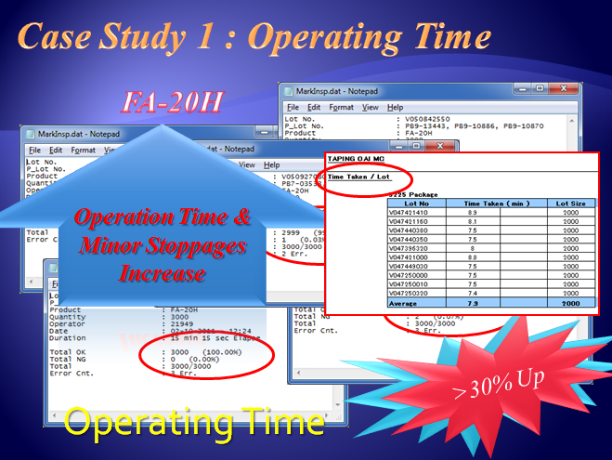
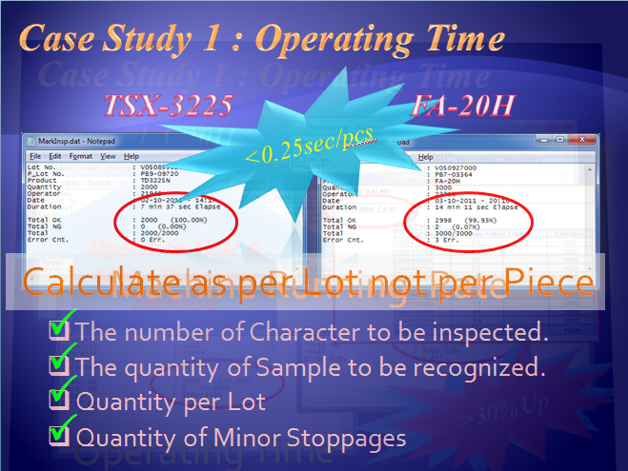
Recap – Accuracy Vs Output
Accuracy
Output
Cycle Time
The number of Character to be inspected.
The quantity of Sample to be recognized.
Quantity per Lot
Quantity of Minor Stoppages

Slide 3
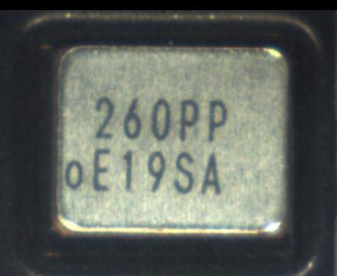
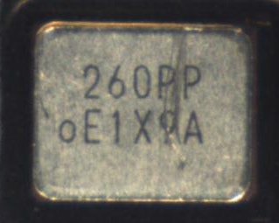

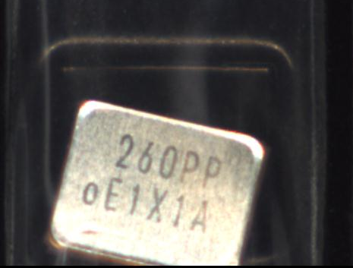
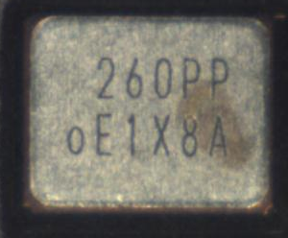
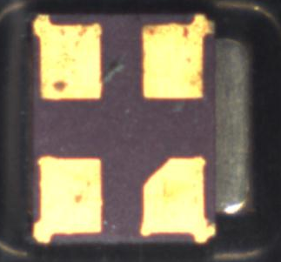
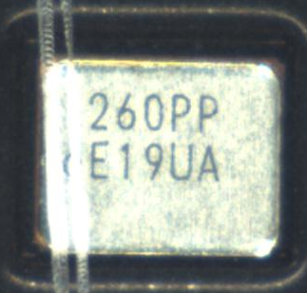
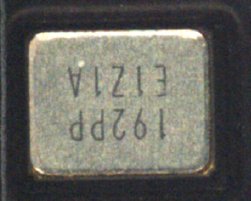
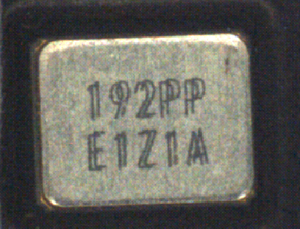
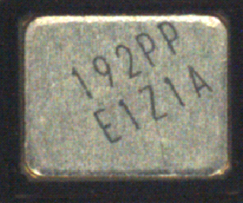
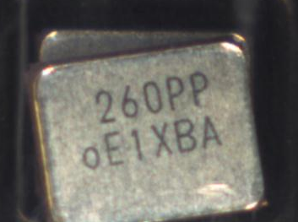
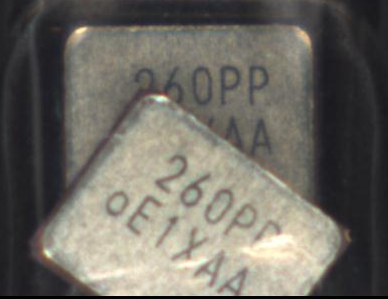
Recap – Overall Achievement
P
OAI Defect : Dirty, Scratch, Marking Defect, Direction
P
Frequency Mixing
P
Week Code Mixing
P
Multi Code
P
Sealing Inspection
P
Support Jumbo Rail
P
Week Code Jumping
P
Top Tape Broken
P
Double Pieces
P
Marking Shift
P
Double Marking

Slide 4
Recap – Establish New Approach
Objective !
To reduce Taping OAI workmanship by 50% with
Review Taping OAI Standard
Implement Taping OAI machine using new Judgment standard
New OAI Judgment Standard
Objective is to detect Sealing Defect (by worker).
To detect Tape Broken (by worker).
To detect Mixing (by machine) – Check Freq. & CL only.
P
Target
Machine Cycle Time : < 0.2 sec
P
6 Machines Ability : 55 mil
P
Confirming Rate : 99%
P
Running Rate : 90%
P
Machine Availability : 29 days; 21.75 hrs

Slide 5
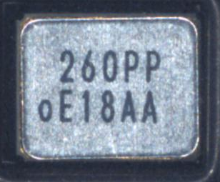
Merits Of New Approach
0 ~ 9 + P = 11
Accuracy
Output
Cycle Time
Reduce Fault Tolerence
0 ~ 9 ; A~ Z = 36
Reduce Minor Stoppages
Reduce Inspection Qty.
Machine Cycle Time < 0.2 sec
Reduce Operation Time
Increase Production Output

Slide 6
Merits Of New Approach
Average < 10min per Lot (3000 Lot Size)

Slide 7
Cause & Effect
Inspection Done By Worker
Sealing Defect
Dirty
Tape Broken
Scratch
Double Pieces
Double Marking
Detection By Marking

Slide 8
Cause & Effect
Inspection Type | Cycle Time = 0.19 sec |  | Cycle Time = 0.28 sec
 | FA-128P | FA-20HP | FA-128P | FA-20HP
Frequency Mixing | P | P | P | P
CL Mixing | P | P | P | P
Mixing Weekcode | O | O | P | P
Weekcode Jumping | O | O | P | P
Marking Shift | P | P | P | P
Wrong Direction | P | P | P | P
Double Pieces | O | O | O | O
Double Marking | O | O | O | O
Sealing Inspection | O | O | O | O
Ability 1 Machine | 9082.80 Kpcs/month | 5950.80 Kpcs/month
Ability 6 Machine | 54496.8 Kpcs/month | 35704.80 Kpcs/month
Customer Claim (FA-128)
QC Reject
Customer Claim (FA-238)

Slide 9
Mixing Of Weekcode

Slide 10
QC Reject : Weekcode Mixing

Slide 11
QC Reject : Weekcode Mixing

Slide 12
QC Reject : Weekcode Mixing

Slide 13
Double Pieces

Slide 14
QC Reject : Double Marking

Slide 15
QC Reject : Double Marking

Slide 16
QC Reject : Double Marking

Slide 17
QC Reject : Wrong Pin Mark

Slide 18
QC Reject : Wrong Pin Mark

Slide 19
QC Reject : Wrong Pin Mark

Slide 20
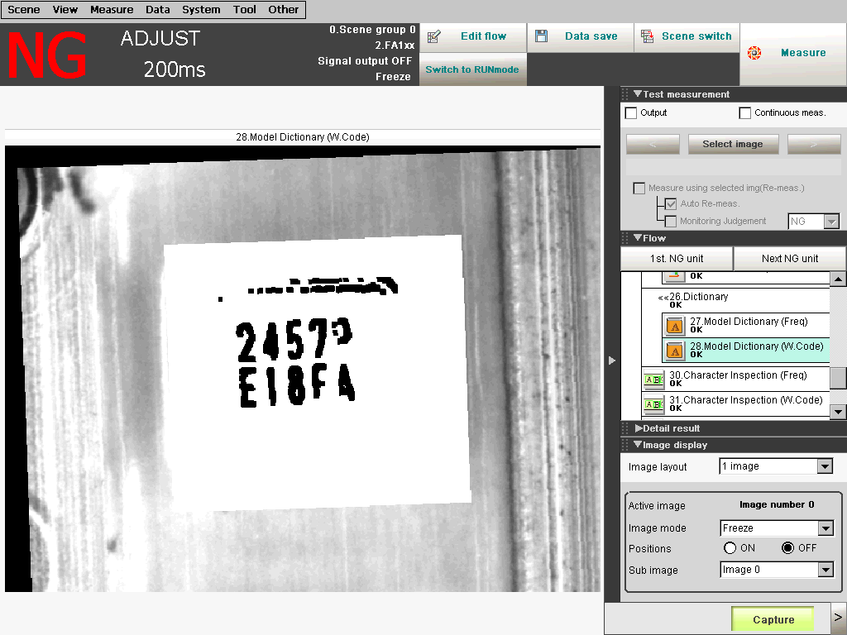
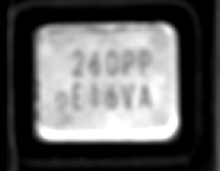

Slide 21
